Slide 1




Progress & Program
David Bresteau, Carlo Spezzani, Julien Lenfant, Michel Bougeard, David Denetierre, François Pollack, Bertrand Carré, Maël Delhinger, Sébastien de Rossi, Franck Delmotte, Olivier Tcherbakoff, Jean-François Hergott, Pascal D’Oliveira, Georges Vigneron, Thierry Ruchon

Slide 2










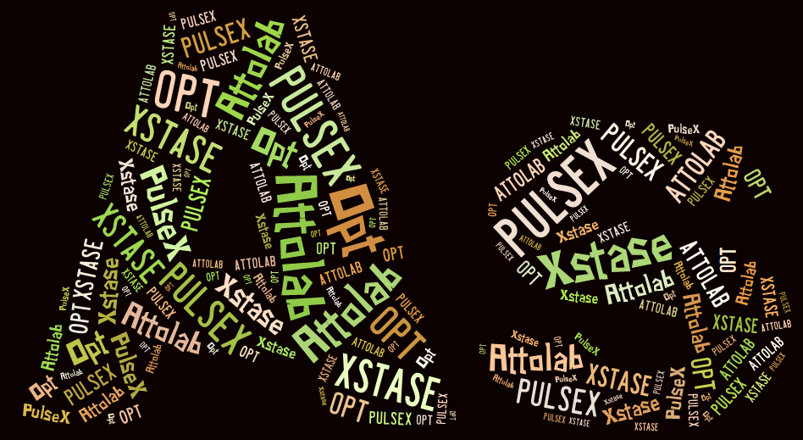
FAB10
http://attolab.fr

Slide 3
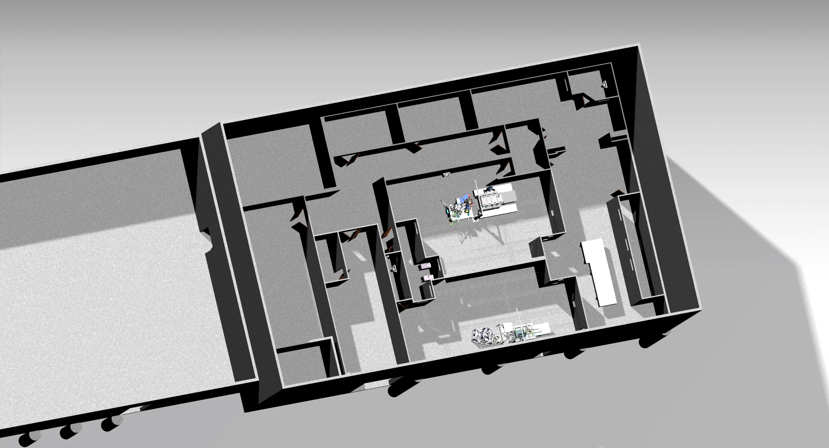
Plan initial (et final)
SE10
SE10
Laser
Laser
SE1
SE1

Slide 4
Plan initial (et final)
Compresseurs
SE10
Laser
SE1

Slide 5
Plan intermédiaire (1er semester)
Compresseurs
SE10
Laser
SE1

Slide 6
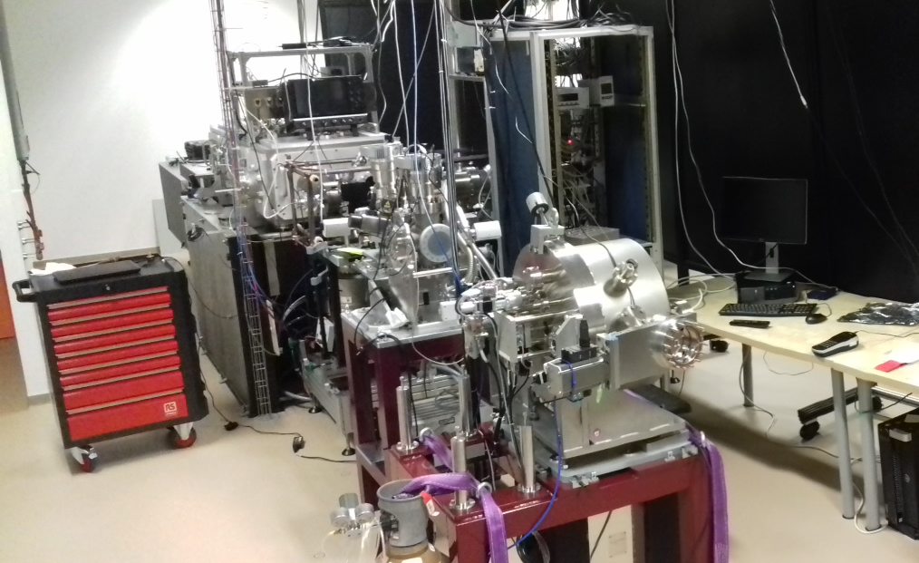
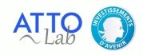
FAB 10 beamline
Atto group @ LIDYL
T. Ruchon, B. Carré, C. Spezzani, D. Bresteau et al.

Slide 7

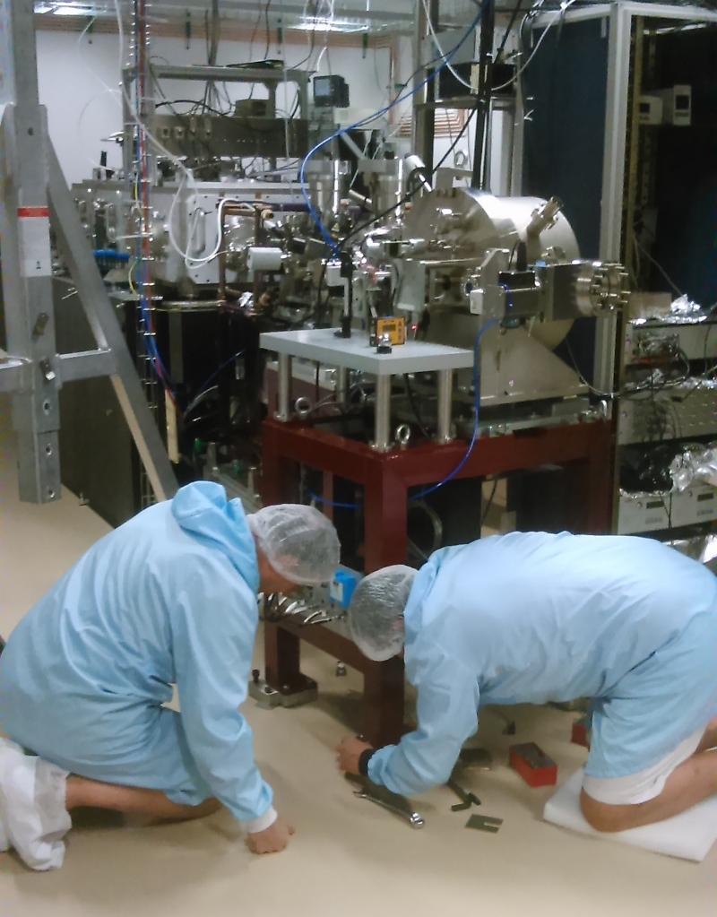
Positioning of the vacuum chambers
Optics & Alignment groups @ SOLEIL
F. Polack, D. Dennetiere et al.
Design office @ LIDYL
M. Bougeard, J. Lenfant, C. Spezzani et al.

Slide 8
Preparation of the lab
Commission de sécurité générale
Validation des lignes de gaz toxique
Mise en place d’une armoire ventilée
Capotage du laser
Contrôle du vide dans les enceintes (RGA)
Mobilier et petit équipement du labo

Slide 9
Plan depuis 01/07
Compresseurs
SE10
Laser
SE1
1,6 mJ, 23-30 fs, profil au foyer en cours, CEP perfectible

Slide 10
A users oriented 10 kHz beamline
“Functions”
Type | XUV ΔE | XUV Δτ | XUV / IR delay
Very broadband (VBB) | 10-30 eV | 100 as
Broadband (BB) | 1-5 eV | 1 fs
Narrowband (NB) | 100 meV | 10 fs
< 100 as
100 as
fs
Transport, control and characterize ultrashort (0.1 - 100 fs) XUV (10 - 100 eV) pulses and carry out time resolved pump-probe applications with sub-fs resolution

Slide 11
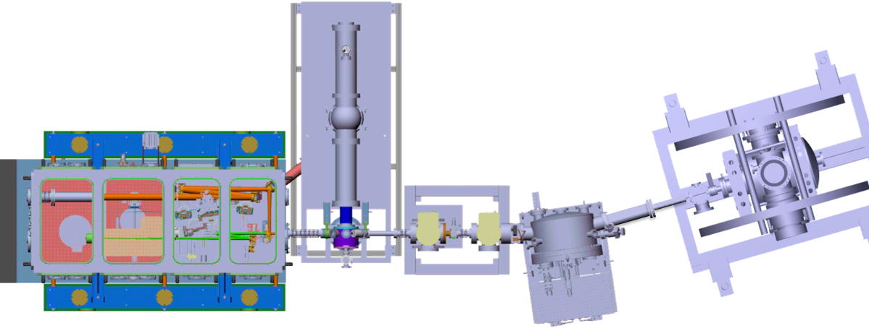
A users oriented 10 kHz beamline
Transport, control and characterize ultrashort (0.1 - 100 fs) XUV (10 - 100 eV) pulses and carry out time resolved pump-probe applications with sub-fs resolution

Slide 12
A users oriented 10 kHz beamline
HHG light source
Ti:Sapph
+
Gas jet/cell
Transport, control and characterize ultrashort (0.1 - 100 fs) XUV (10 - 100 eV) pulses and carry out time resolved pump-probe applications with sub-fs resolution

Slide 13
A users oriented 10 kHz beamline
XUV Spectrometer
Transport, control and characterize ultrashort (0.1 - 100 fs) XUV (10 - 100 eV) pulses and carry out time resolved pump-probe applications with sub-fs resolution

Slide 14
A users oriented 10 kHz beamline
Three-way monochromator: “function selection”
Transport, control and characterize ultrashort (0.1 - 100 fs) XUV (10 - 100 eV) pulses and carry out time resolved pump-probe applications with sub-fs resolution

Slide 15
A users oriented 10 kHz beamline
XUV + IR focusing at MBe⁻S for on-line RABBIT measurements
Transport, control and characterize ultrashort (0.1 - 100 fs) XUV (10 - 100 eV) pulses and carry out time resolved pump-probe applications with sub-fs resolution

Slide 16
A users oriented 10 kHz beamline
Differential pumping stages for UHV applications
10⁻⁸ mbar with ionic pump off
Transport, control and characterize ultrashort (0.1 - 100 fs) XUV (10 - 100 eV) pulses and carry out time resolved pump-probe applications with sub-fs resolution

Slide 17
A users oriented 10 kHz beamline
Three-way monochromator: “function selection”
XUV/IR refocusing and recombination
at the user
end-station
Transport, control and characterize ultrashort (0.1 - 100 fs) XUV (10 - 100 eV) pulses and carry out time resolved pump-probe applications with sub-fs resolution

Slide 18
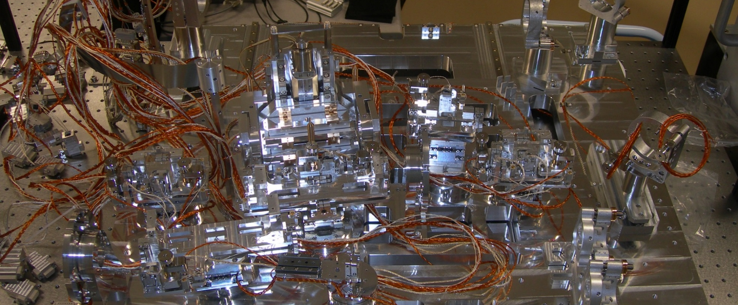
The « function » selector

Slide 19
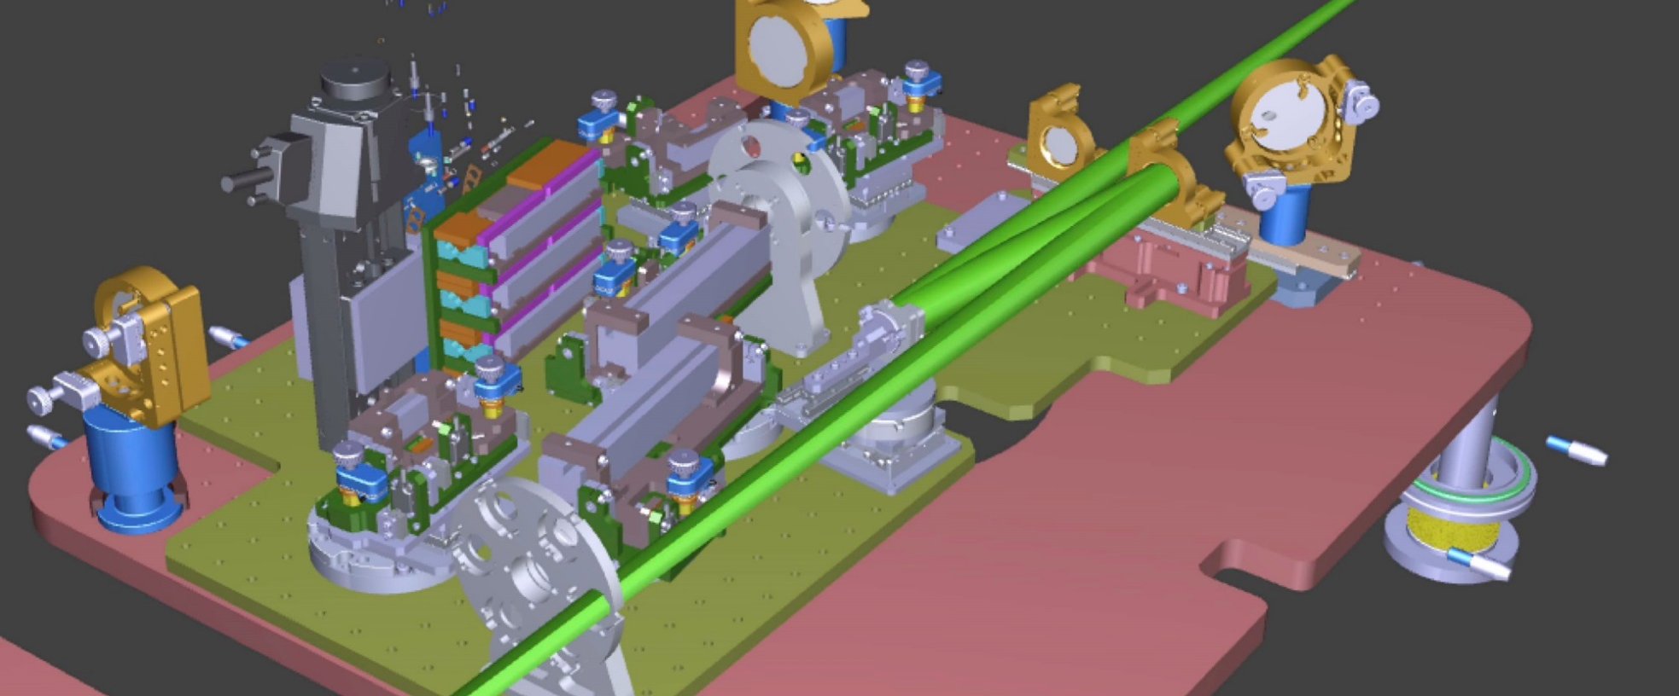
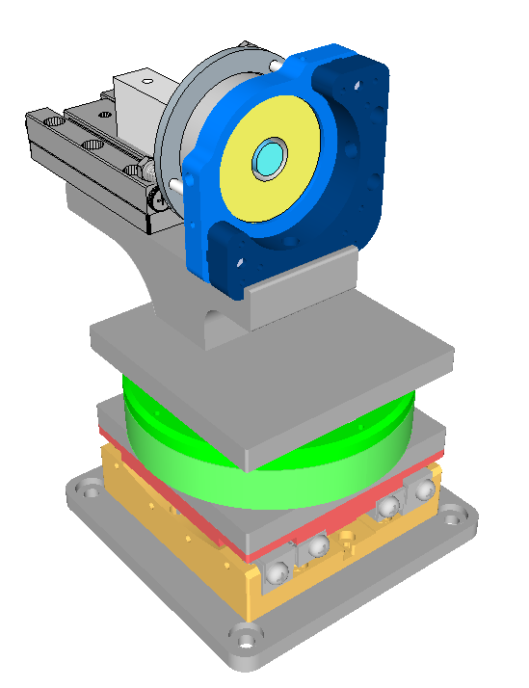
BroadBand line
Wavelength and bandwidth are selected by multilayer coatings in reflection
Coaxial IR recombination

Slide 20
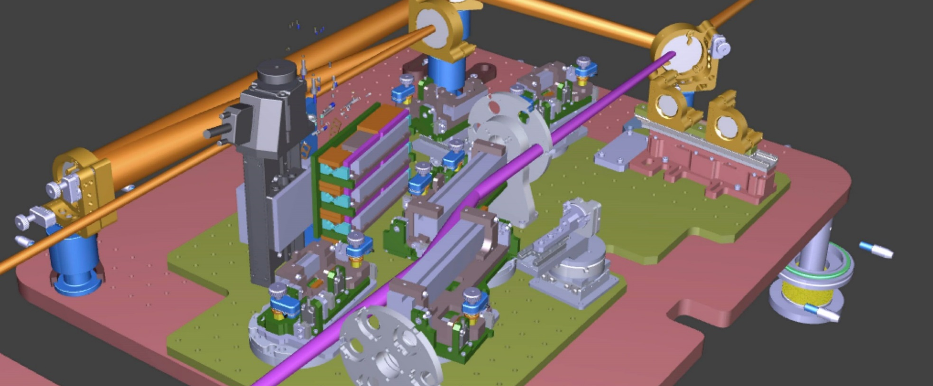
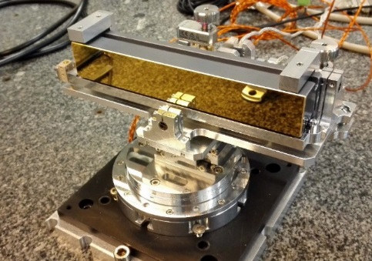
Very broadBand line
Grazing Au coated mirrors (WinlightX) for full bandwidth transmission
Coaxial IR recombination on separated branches

Slide 21
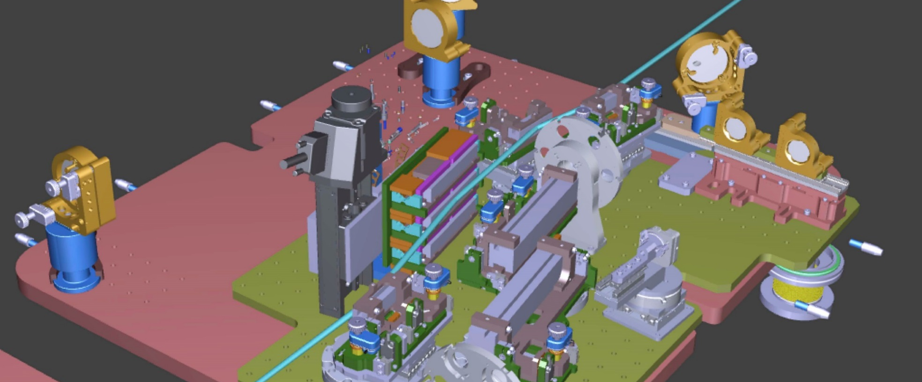
Narrow Band line
Conical diffraction monochromator for tunable wavelength selection (ΔE≈100 meV)
External IR recombination

Slide 22
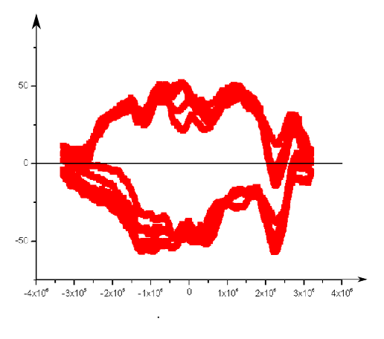
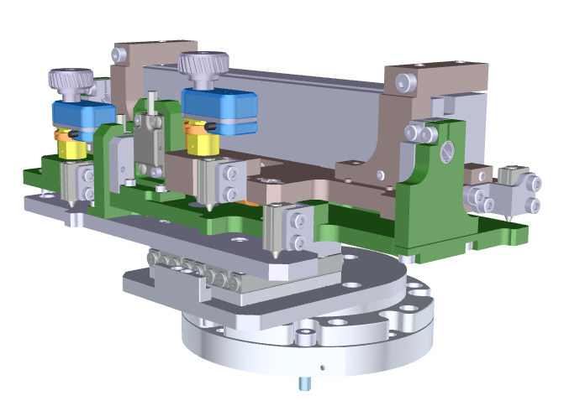
SE10 optic mounts metrology
Residual
angle (µrad)
Drawing of a toric mirror mount (backview)
Forward
direction
≈ 100 µrad
precisison
Backward
direction
SmarAct Translation axis
Position on the axis (a.u.)
Back and forth autocollimation recording on each axis
to check mechanical reproducibility

Slide 23
The « function » selector

Slide 24

The « function » selector
Commissioning: almost finished
All movements operational and on specs (tested at SOLEIL)
All motors computer controlled on a single users interface
VBB in use
NB prepositioned
BB: missing optics

Slide 25
Diagnostic of the beamline
XUV spectrum on line
Camera
(XUV spectrum)
Camera
focus
Camera
(users focus)
RGA
Camera
+ YAG
RGA
Camera (Pointing 1)
Camera (pointing 2)
Camera
(plasma)
Duration on line ?

Slide 26
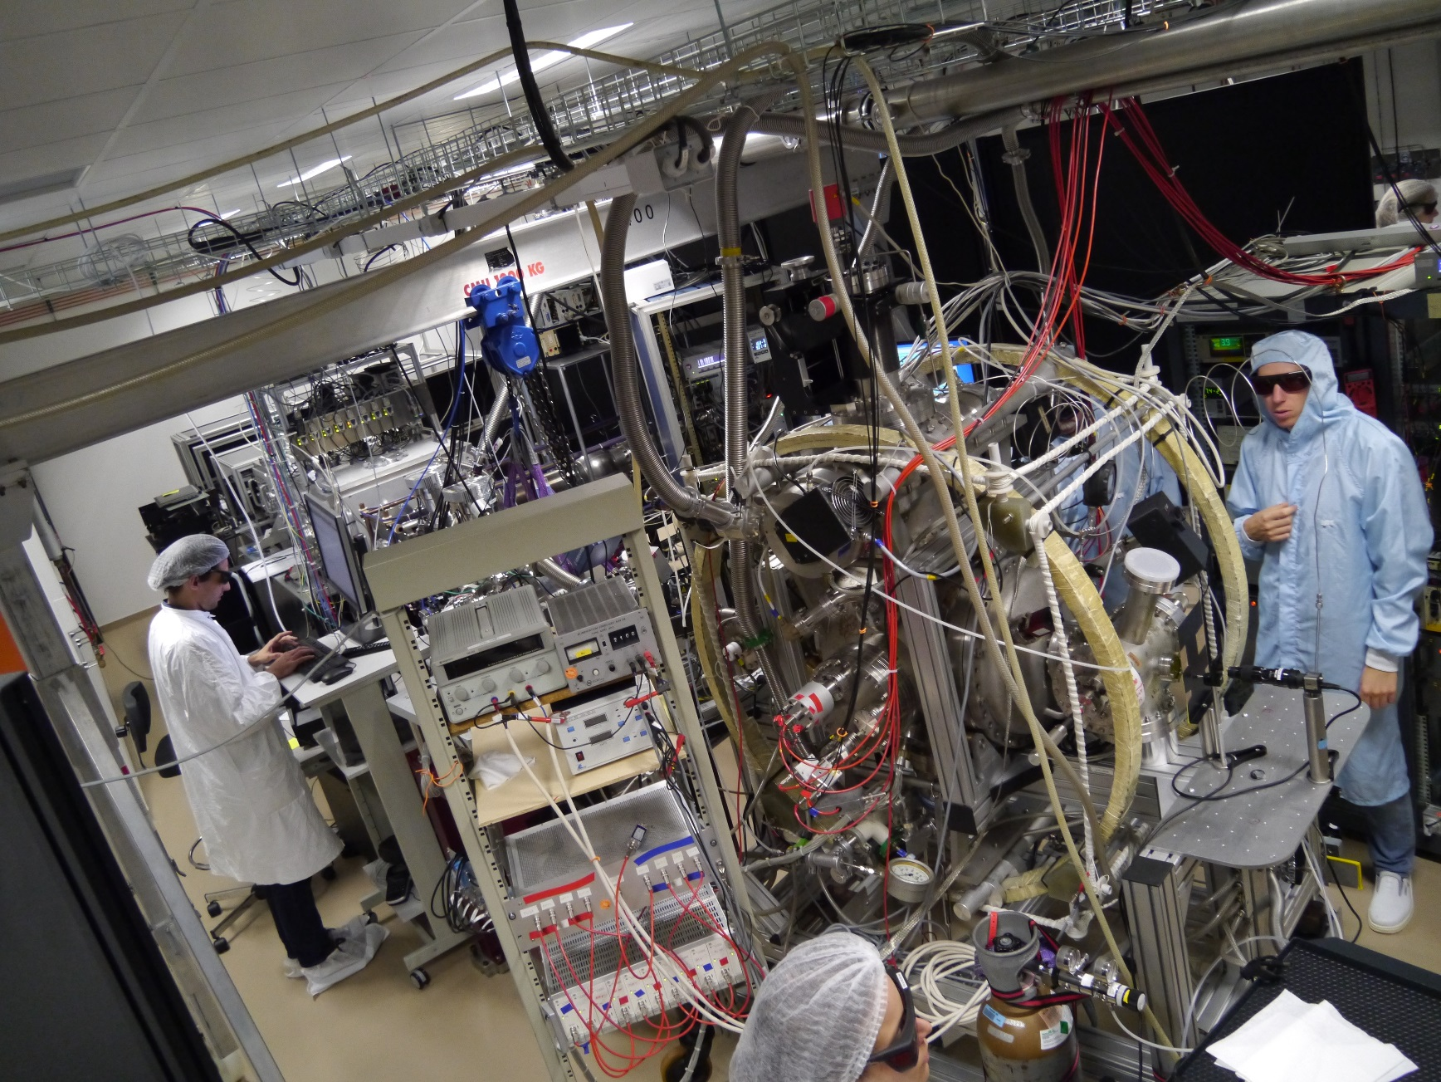
Becoming operationnal now
Picture on 06/10/2017

Slide 27
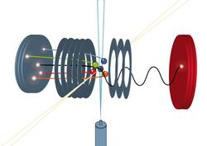
First experiments in a COLTRIMS
Objective: measurements of angurlarly resolved photoionization time delays in molecules
Coincidence experiments: full measurement in the molecular frame of ion and electron momenta
http://www.weltderphysik.de/thema
Test case: photoionization of Ar
Bi-dimensionnal histogram of electron velocities components
Danielle Dowek et al.

Slide 28
FAB 10 : what’s next?

Slide 29
Next milestones
Rationalization of Pumping control (Ismaël Vadillo-Torre)
DurAtion measurements (RABBIT – David and TR)
Rationalization of acquisition/analysis tools (Nicolas Moisan)
Optimization of HHG flUxes/spectra (David & TR)
New frame for the TOF + slits of NB (David, TR and Carlo)
Pump lIne for NB + setting BB (David, TR and Carlo)
Testing of YAG diagnosis and ONline recording

Slide 30
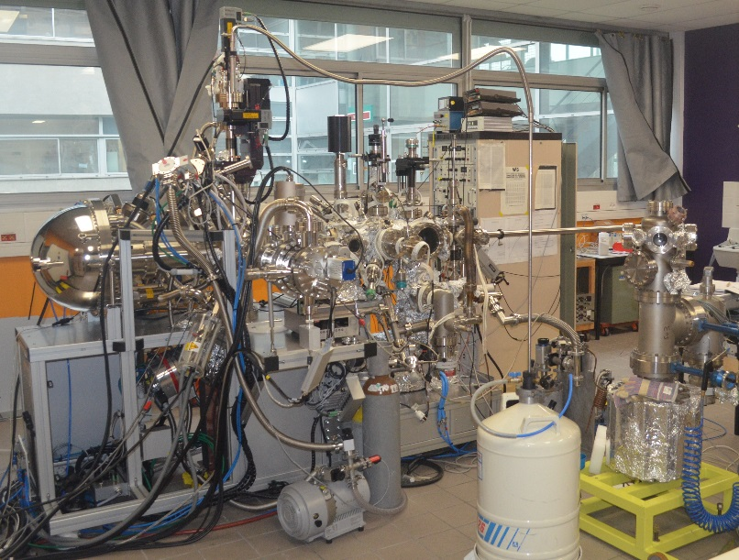
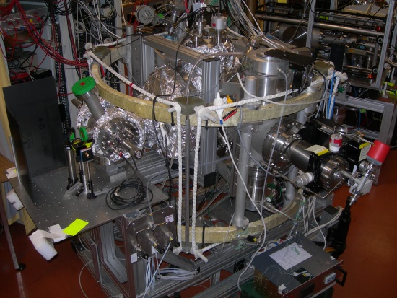
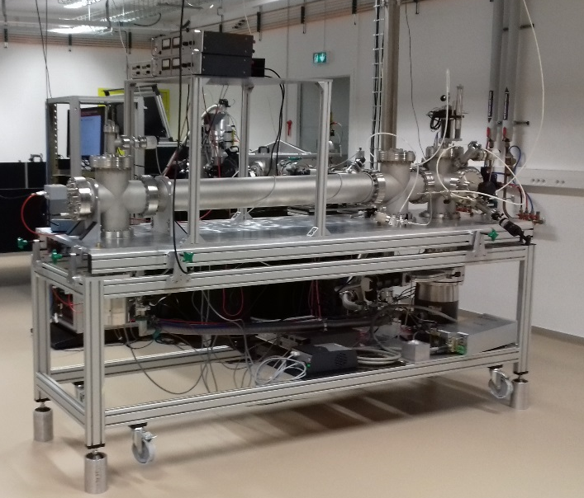
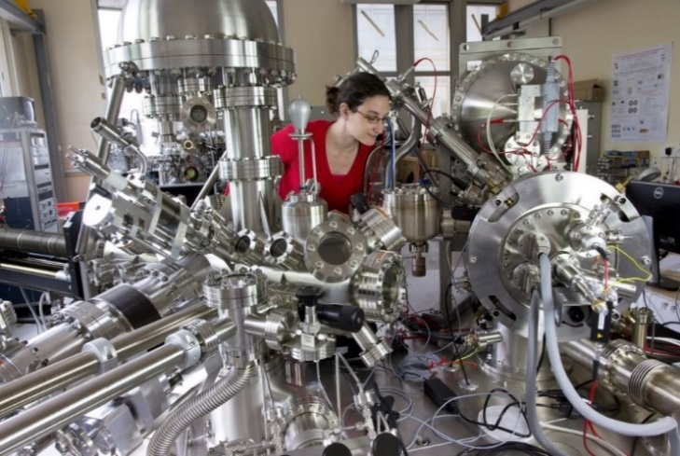
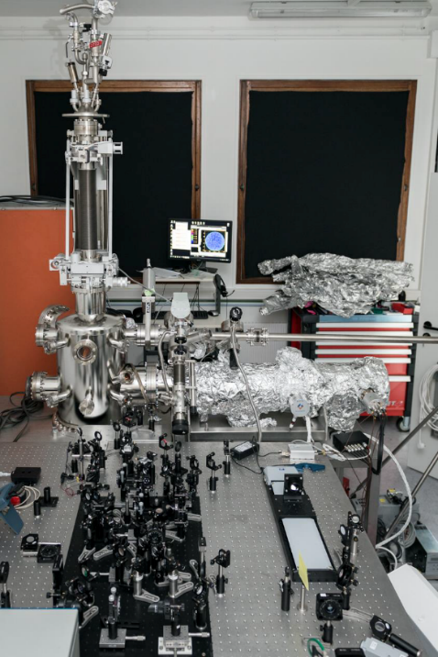
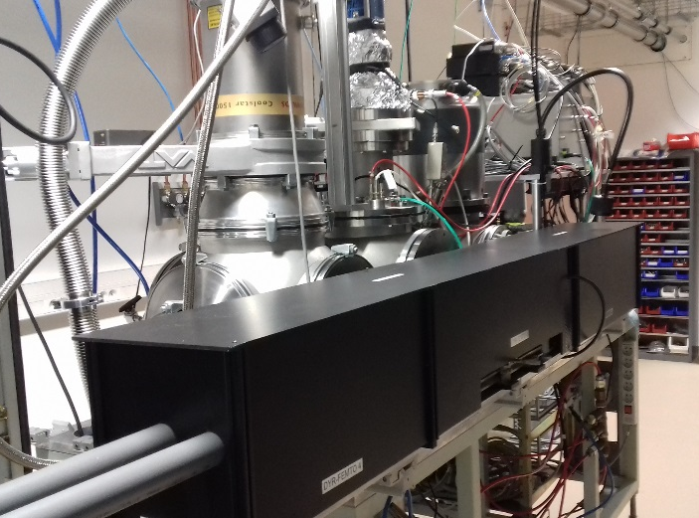
For a large collection of end stations
COLTRIMS
TOF-SPIN
X-PEEM
TOF-MBES
Time resolved ARPES
(ARTOF)
VMIS

Slide 31
Conclusion
Sharing of primary pumping lines?
Computer controls of translations?
Recordings on line: what? When?
Access forms: getting more efficient…

Slide 32
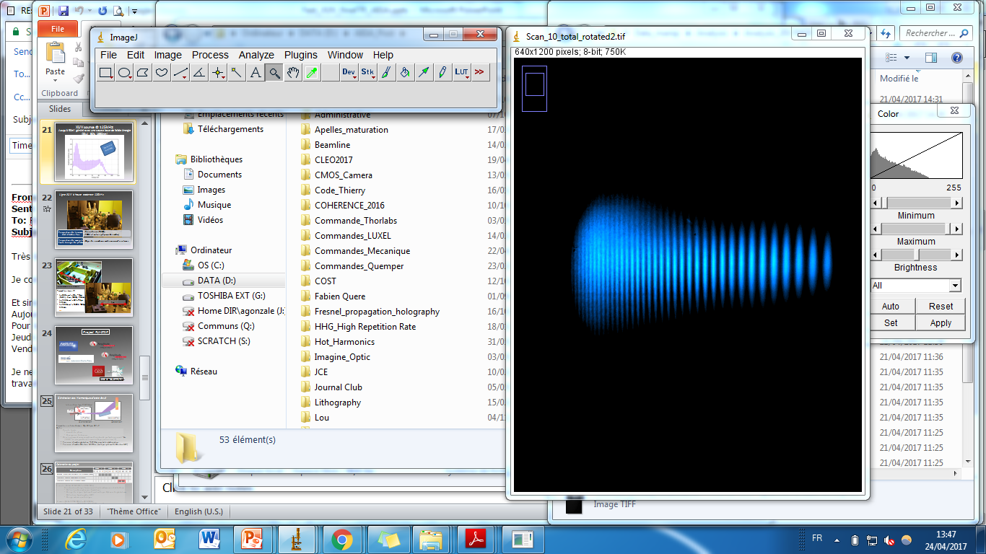
Outlook
Higher intensity on target (SN 3.0)
Shorter IR pulses (2018)
Higher repetitions rates (Yb-fiber lasers) (100-200 kHz) (2019?)
140 eV @ 125 kHz

Slide 33








http://attolab.fr

Slide 34

Organization - access
Executive Committee (Partners)
realizing equipment
planning exploitation
~ 10 meetings /year
Steering Committee (Institutions)
controlling realization and exploitation
2 meetings/year
Institution | member
Coordinateur | B. Carré
CEA | H. Desvaux
CNRS-INP | A. Lambrecht
Ecole Polytechnique | G. Petite
ENSTA | D. Boschetto
IOGS | P. Georges
PSUD | E. Augé
SOLEIL | C. Nicolas
UCP | K. Hricovini
type | access (%) | assessment
Laser R&D maintenance | 20% | Steering Committee
Consortium programs + collaborations | 60% | Steering Committee
national users | 10% | External (Femto nal network)
European/international users | 10% | External (Laserlab-Europe)
First external call end 2017

Slide 35

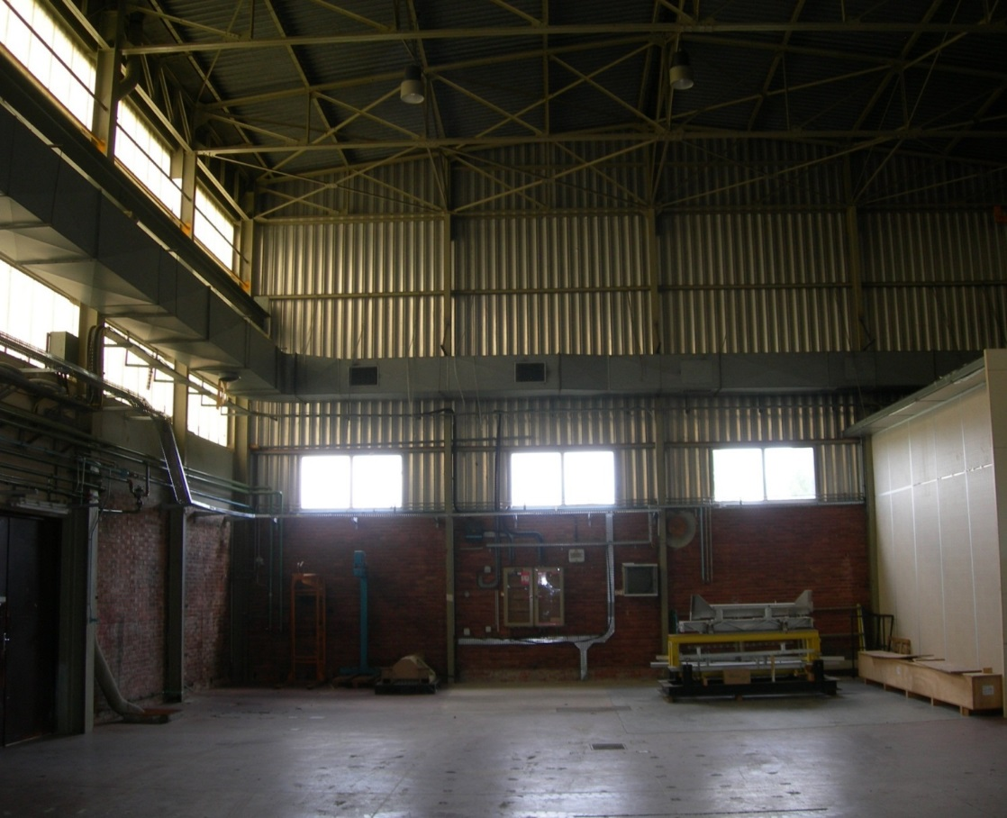
With new premises at l’Orme les merisiers

Slide 36
630 m²
Laser R&D
630 m² of ISO 8 clean rooms delivered end of 2015
Air cond.
Laser
FAB1 kHz
FAB10 kHz
Exp room SE10
Exp room SE1
workshop

Slide 37

Laser FAB1-10
Joint development with
≈15fs; 15mJ
FAB1
Ampli. 1kHz
Post compression and/or XUV beamlines
TOPAS @ 1kHz
800nm; 10kHz
Low energy part (Front end at 10 kHz)
CEP stabilized
Tunable (50 fs)
FAB10
Ampli. 10kHz
≈15fs; 2mJ

Slide 38
Budget : ATTOLAB – cofunding
ATTOLAB
Tranche 1 [01/10/2012 – 30/06/2016] : 3 M€ (total spent)
Tranche 2 [01/01/2014 – 31/12/2019] : 2 M€ (40% engaged)
Associated programs in 2012-2019 period (> 8 M€): leverage effect
Partner | Type cofinancing | Cofinancing | Objet | budget (€)
LIDYL | PUBLIC-AUTRES-ORGANISMES | CEA | E1 : LIDYL Building | 2000000
LIDYL | PUBLIC-ANR | Labex PALM / IMAPS | E1 : pdoc-2year (A. Borot) | 130000
LIDYL | INTERNATIONAL-COMMISSION-EUROP | ITN MEDEA | E1 : PhD (C. Alexandridi) | 145000
LIDYL | PUBLIC-ANR | ANR16-défis / CIMBAAD | E1 : HHG | 270923
LIDYL | PUBLIC-ANR | ANR14-JC / XSTASE | E2 : HHG | 200000
LIDYL, ISMO | PUBLIC-COLLECTIVITES | Région IdF 2015 / PULSE-X | E2 : HHG | 390000
LIDYL, LCF, SOLEIL | PUBLIC-AUTRES-ORGANISMES | FCS Paris-Saclay LIDEX OPT2X | E2 : HHG | 700000
LOA, LIDYL | PUBLIC-COLLECTIVITES | Région IdF 2012 / ATTOLITE | E2 : laser | 1000000
SOLEIL, LCF | PRIVE-ENTREPRISES | Synchrotron SOLEIL | E3 : permanent staff | 130000
SOLEIL | PUBLIC-ANR | Labex PALM / ULTRAFAST-X | E3 : senior chair (Pr F. Gelmukhanov) | 140000
LPS | PUBLIC-COLLECTIVITES | Région IdF 2013 / FASTMAP | E4 : elec spectro ARTOF | 300000
LPS | PUBLIC-AUTRES-ORGANISMES | Labex PALM / FASTMAP | E4 : elec spectro FASTMAP | 207000
LPS | PUBLIC-AUTRES-ORGANISMES | Equipement CNRS / FASTMAP | E4 : elec spectro FASTMAP | 120000
LPMS | PUBLIC-ANR | Equipex2011 PATRIMEX | E4 : elec spectro TOF-SPIN | 305654
LPMS | PUBLIC-AUTRES-ORGANISMES | UCP | E4 : elec spectro TOF-SPIN | 60000
LOA | PUBLIC-AUTRES-ORGANISMES | ANR14-défis / APERO | E5 : chamber | 200000
LOA | PUBLIC-COLLECTIVITES | ASTRE 2015 / CISSCO | E5 : chamber - solid target | 100000
LOA | INTERNATIONAL-AUTRES | ELI-ALPS | E5 : laser | 530000
LOA | PUBLIC-AUTRES-ORGANISMES | ENSTA | E5 : laser | 300000
LOA, LIDYL | PUBLIC-ANR | Labex PALM / OPTIWAVE | E5 : laser | 360000
LCF | PRIVE-ENTREPRISES | IOGS | E6 | 114515
LCF | PUBLIC-ANR | Equipex 2011 MORPHOSCOPE | E6 | 150000
LCF | PUBLIC-COLLECTIVITES | Région IdF 2012 / CeMOX | E6 | 259000
 |  |  |  | 8112092

Slide 39
Operating cost 2017-2019 and beyond
2017-2019 : ~1300 k€ (infrastructure excluded) - covered by ATTOLAB-T2
 | annual operating costs (k€ - estimate) |  |  |  |  | After 2019 : expected funding (k€)
site | infrastructure | beamlines | endstations | Total/year | Cost/week | [Institutions] | [research contr] | [private contr] | Paris-Saclay | [Access] | Total
LIDYL | 126 | 271 | 20 | 417 | 4,3 | 126 | 201 | 50 | 20 | 20 | 417
other Users |  |  | 60 | 60 | 0,6 |  | 50 | 10 |  |  | 60
LOA | 100 | 100 | 20 | 220 | 2,3 | 100 | 50 | 50 |  | 20 | 220
LCF | 100 |  | 50 | 150 | 3,4 | 100 |  | 30 |  | 20 | 150
Total (k€) | 326 | 371 | 150 | 847 |  | 326 | 301 | 140 | 20 | 60 | 847
After 2019 : ~ 520 k€ / year (infrastructure excluded)
Public research contracts (local, national, European)
Private contracts : research institutions (ELI-ALPS), industrials.
Paris-Saclay University contribution : ATTOLAB shared platform
Fees for access (external users, industrials)

Slide 40
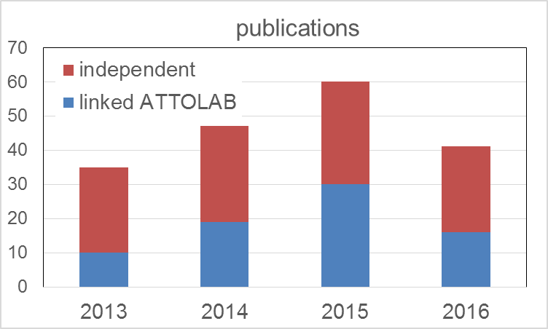
Strategy - perspectives
 |  | 2012 | 2013 |  |  |  | 2014 |  |  |  | 2015 |  |  |  | 2016 |  |  |  | 2017 |  |  |  | 2018
 | Operations | 4 | 1 | 2 | 3 | 4 | 1 | 2 | 3 | 4 | 1 | 2 | 3 | 4 | 1 | 2 | 3 | 4 | 1 | 2 | 3 | 4 | 1 | 2 | 3 | 4
E0 | LIDYL : hall development
E1 | FAB1-FAB10 development
E1 | scientific program on FAB1-FAB10
E3 | Gas phase : test workstations
E3 | Gas phase : scientifc programm
E4 | Solid-state : development workstations
E4 | Solid-state : scientifc program
E5 | LOA : development of SN2.0 laser
E5 | LOA : development of SN3.0 laser
E5 | LOA : SN2.0 - scientific program
E6 | LCF : CeMOX development
E6 | LCF : CeMOX exploitation
ATTOLAB combines two lines:
building on synergy [light sources – optics - interdisciplinary users]
collective, successful effort
response to users’ requests with limited compromise on performance.
developing unique expertise/techniques
amplitude & phase nonlinear spectroscopy (RABBIT)
production of isolated atto pulses (2-color synthesis, atto lighthouse)
control of light angular momentum
controlled pulse for plasma physics in relativistic regime
XUV optics and metrology
Confidence in mid- to long term operation and evolution

Slide 41
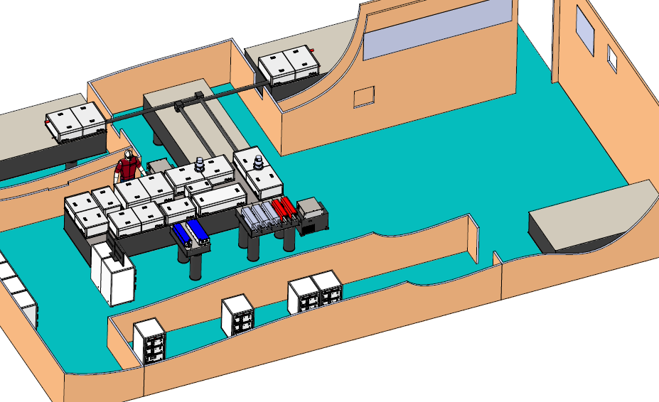
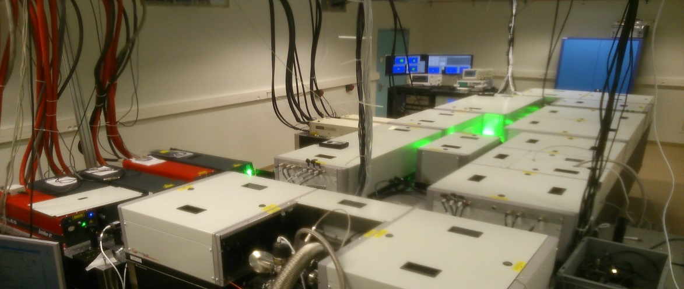
Laser commissionned june 2016

Slide 42
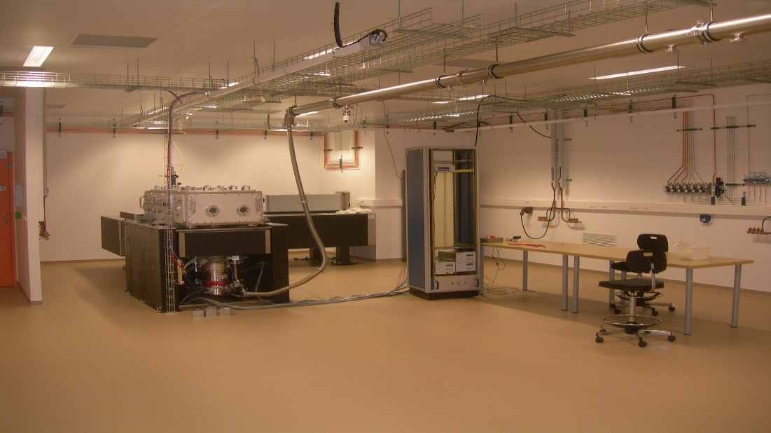
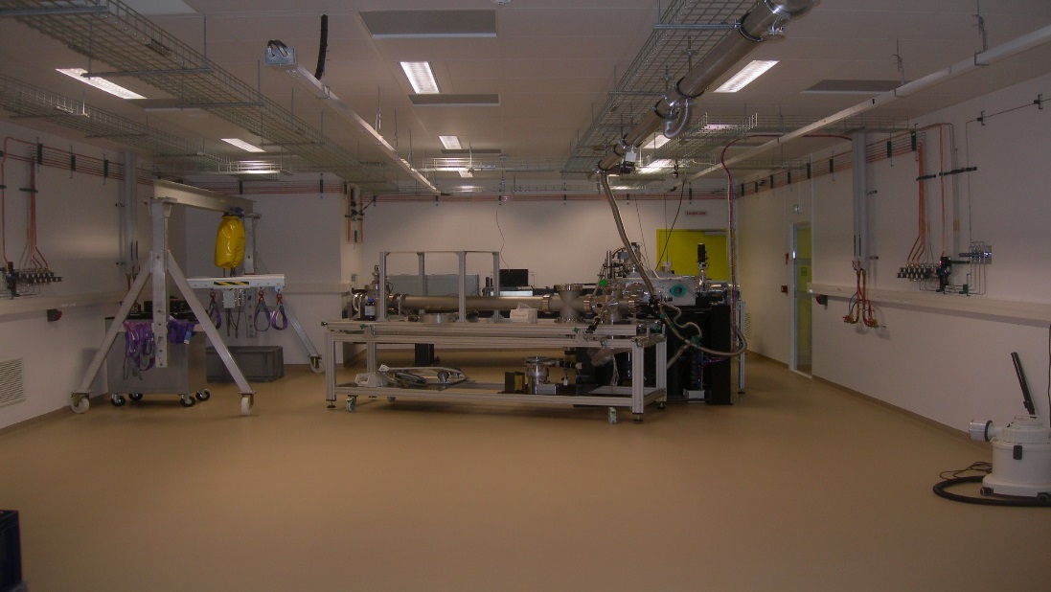
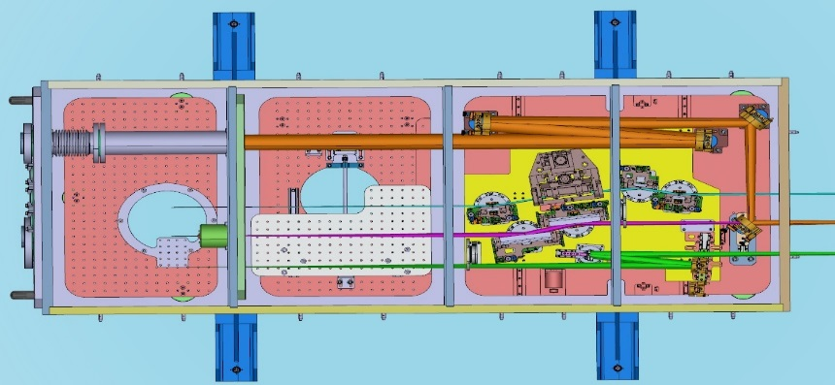
2 experimental rooms (100 m2)
Opened for users: end 2016

Slide 43
2013
New premises at l’Orme les merisiers

Slide 44
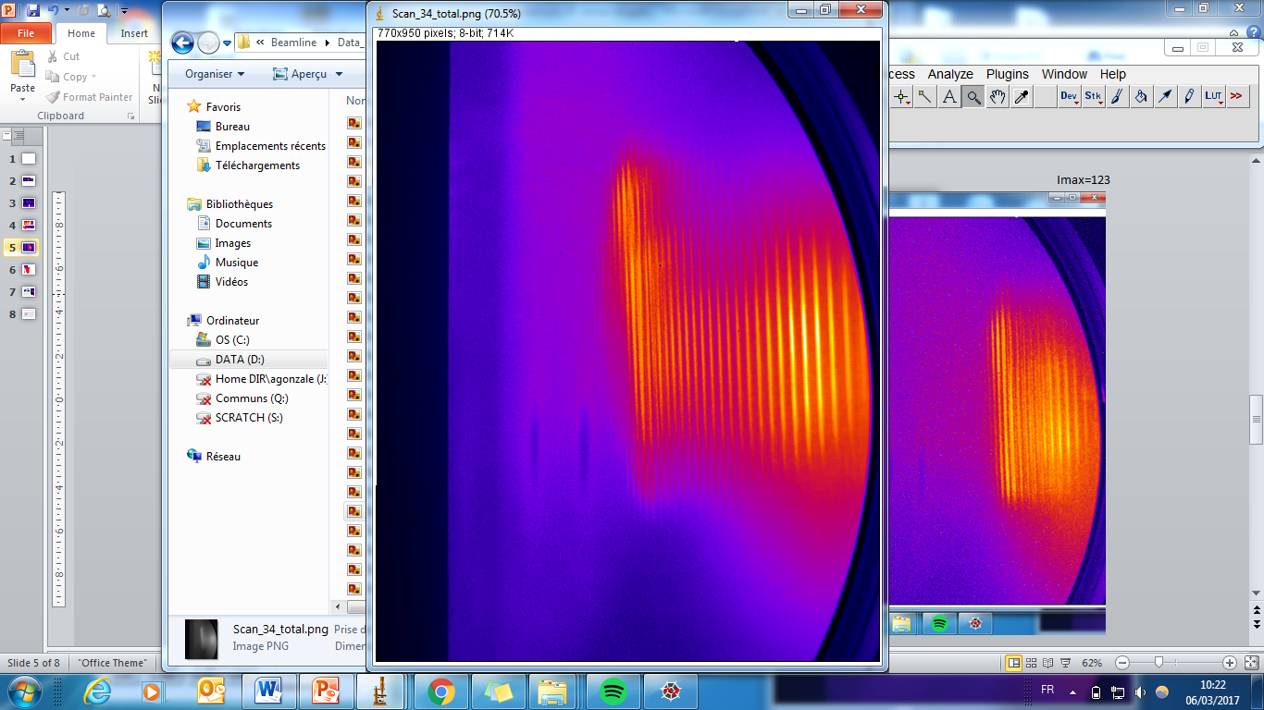
Un Spectre typique @ 1500 nm
Une source XUV femtoseconde ultracompacte

Slide 45
A consortium of 9 labs in Saclay
Full vertical integration from femtosecond lasers to
XUV attosecond pulses users

Slide 46
A consortium of 9 labs in Saclay
fs lasers + as XUV sources
Solid state physics
XUV optics
Fs laser and XUV sources with plasmas
Gas phase
Budget with associated projects:
10 M€
http://attolab.fr/

Slide 47
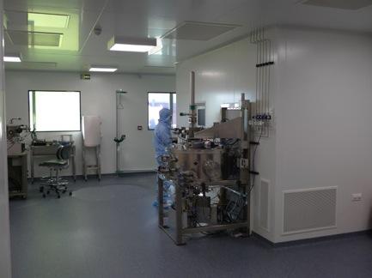

XUV optics design on demand
magnetron sputtering Plassys MP800S
CeMOX : platform for X-ray optics
F. Delmotte, S. deRossi et al.

Slide 48


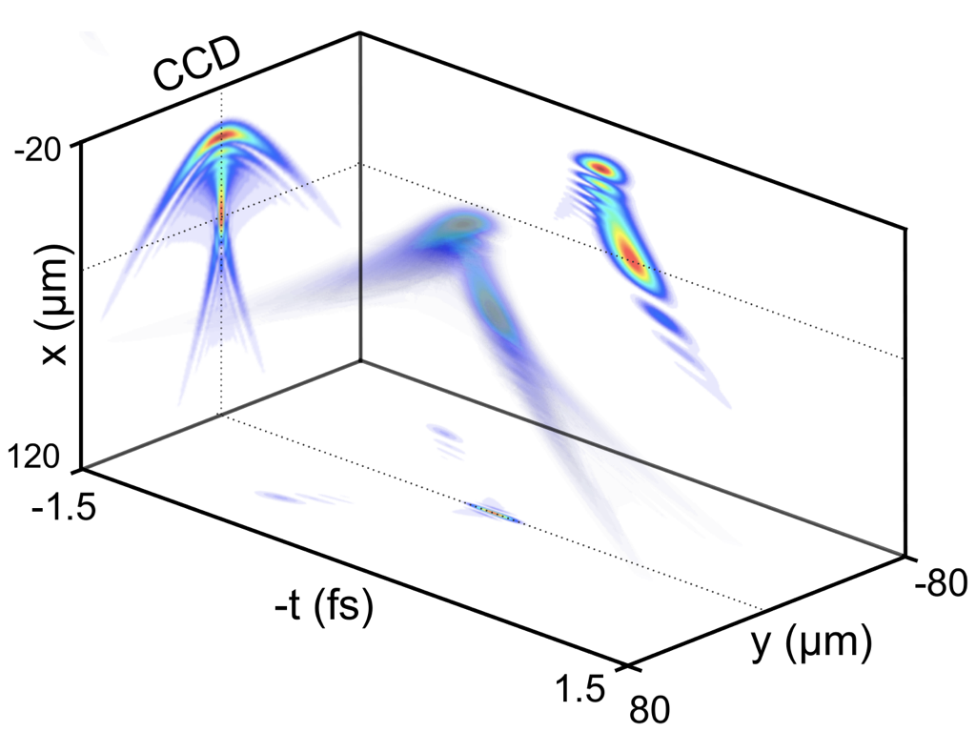
XUV optics design on demand
Post-compression
Spatio-temporal couplings
CeMOX : platform for X-ray optics
F. Delmotte, S. deRossi et al.

Slide 49

High performance optomechanics
Optics & Alignment groups @ SOLEIL
F. Polack, D. Dennetiere et al.
Design office @ LIDYL
M. Bougeard, J. Lenfant, C. Spezzani et al.

Slide 50
High performance optomechanics
Optics & Alignment groups @ SOLEIL
F. Polack, D. Dennetiere et al.
Design office @ LIDYL
M. Bougeard, J. Lenfant, C. Spezzani et al.

Slide 51
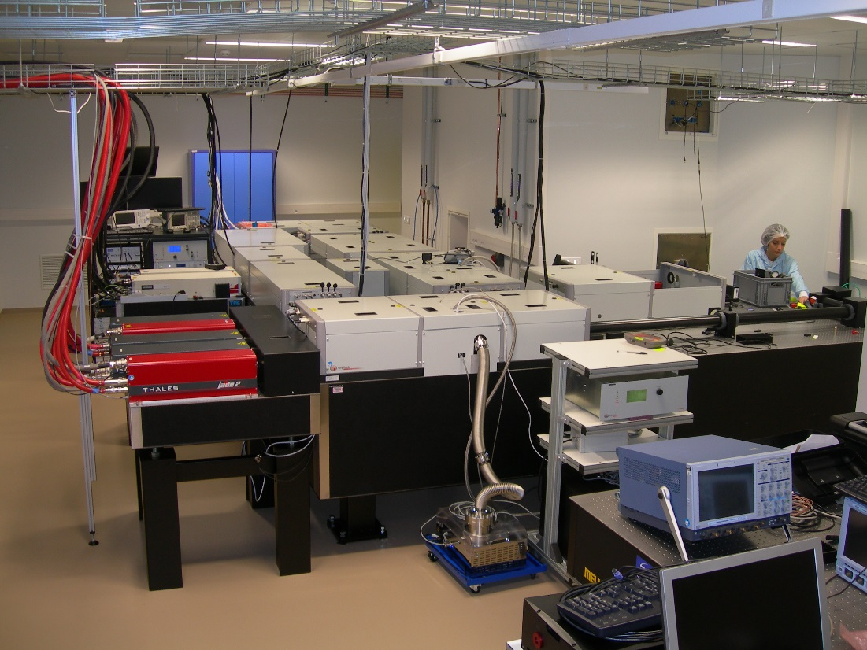
State of the art laser systems
FAB 1: 15 W (15 mJ/1 kHz), 24 fs (15 fs in 2018), CEP shot to shot: 350 mrad
FAB 10: 20 W (2 mJ/10 kHz), 24 fs (15 fs in 2018), CEP shot to shot: 250 mrad
SLIC group @ LIDYL
P. D’Oliveira, J.-F. Hergott, O. Tcherbakoff et al.

Slide 52
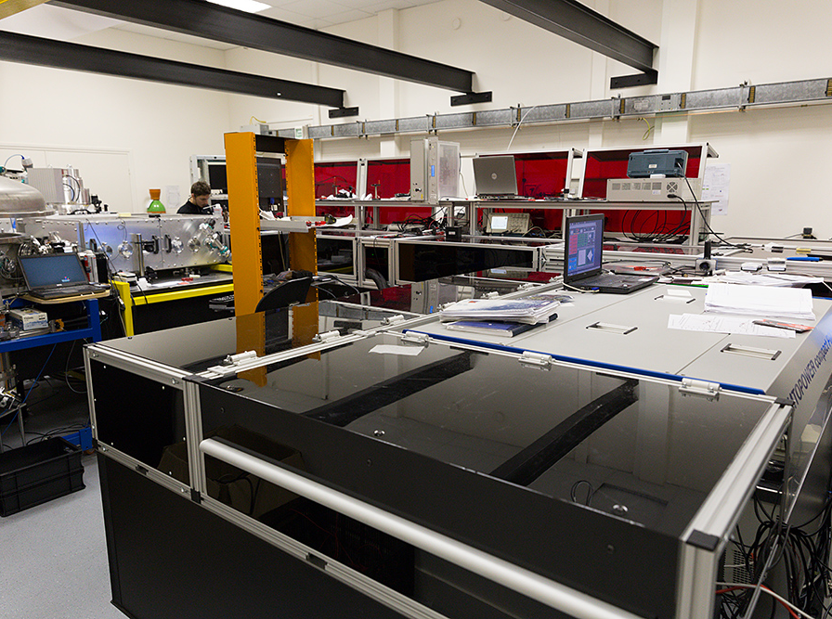
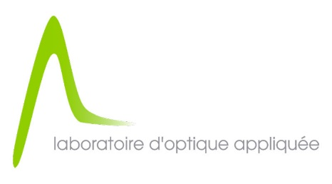

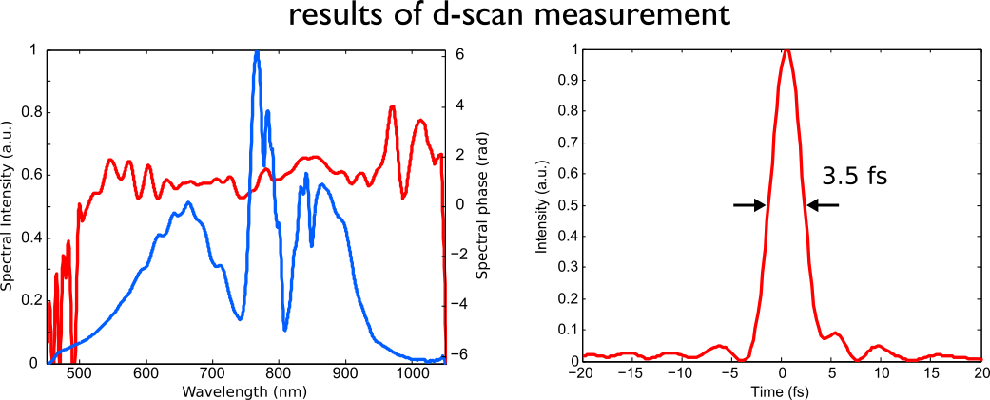
State of the art laser systems
2,5 mJ
SN 2.0 (2016): 2.5 mJ/ > 10¹⁸ W/cm² , 24fs - 3.5 fs, 1 kHz, Contrast >10¹⁰ (@ 10 ps) CEP <350 mrad
SN 3.0 (2018): 10 mJ/ > 10¹⁹ W/cm² , 20fs - 3 fs, 1 kHz, Contrast >10¹¹ (@ 10 ps) CEP <200 mrad
PCO group @ LOA
R. Lopez-Martens, S. Haessler et al.

Slide 53
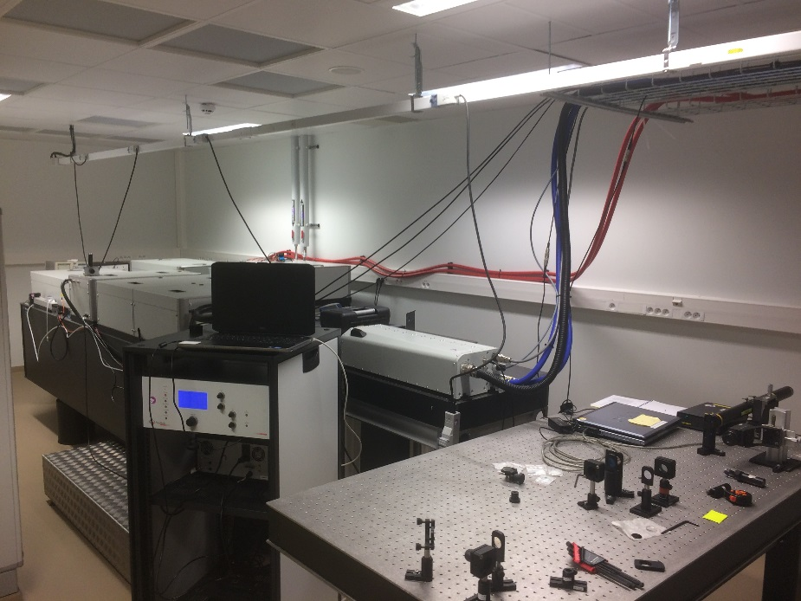


State of the art laser systems
…With direct connection to industrial progess
Joint lab
SLIC group @ LIDYL
P. D’Oliveira, J.-F. Hergott, O. Tcherbakoff et al.

